Slide 1

Service Portfolio Governance
Cloud based solution for Service Portfolio Governance
May 2019

Slide 2
Shifts in portfolio complexity
Service Level Management |Portfolio Overview
Notes:
Digitization1 has made the applications
portfolio both more complex and more
central to the delivery of business value.
Shift 1—From process automation to productivity
and revenue generation
Shift 2—From central applications ownership to
Geographically distributed ownership
Shift 3—From large-scale projects to iterative
releases and enhancements – frequenct changes

Slide 3






Service Portfolio Governance - Proposed SaaS Solution
Portfolio governance as service that tracks SLA, Legal Contracts, Knowledge transfer documents, RACI Matric and other details at individual service level
Give stakeholders role-specific content and navigation to views and functionality that are relevant to their positions
Govern your service portfolio by creating clear responsibility for IT governance, data capture, SLA and compliance
Integration with existing tools
Manage multiple Portfolios across geographies
Monitor service portfolio to ensure that it aligns with contractual requirements

Slide 4



Solution Overview
OE Specific
Service Level Management |Portfolio Overview

Slide 5
Solution Overview
Portfolio view
Service Level Management |Portfolio Overview | DE
Service Package 1
Service Package 2
Service Package 3
Service Package n

Slide 6
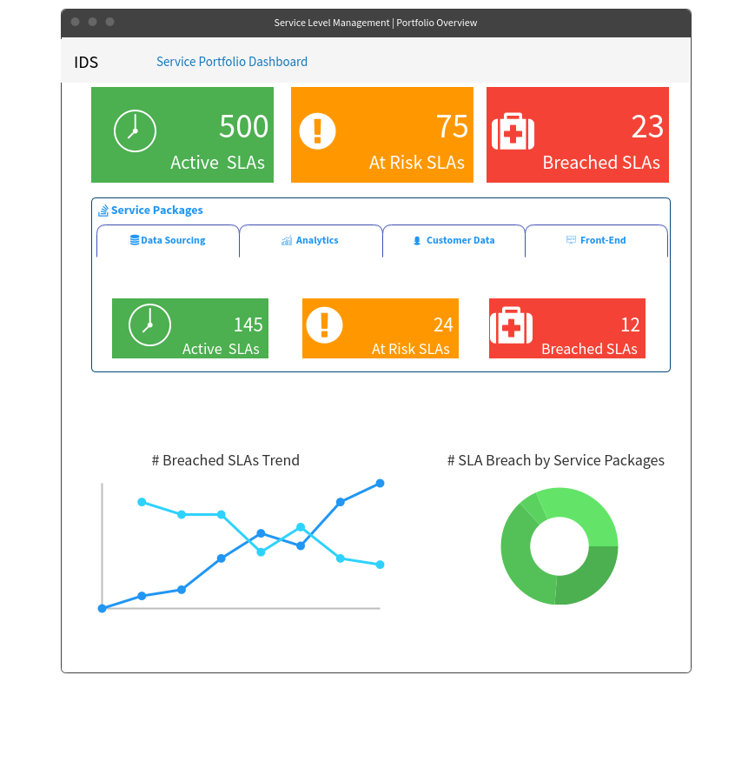
DASHBOARD view – E.g., IDS
Portfolio level
Service Level Management |Portfolio Overview | DE

Slide 7
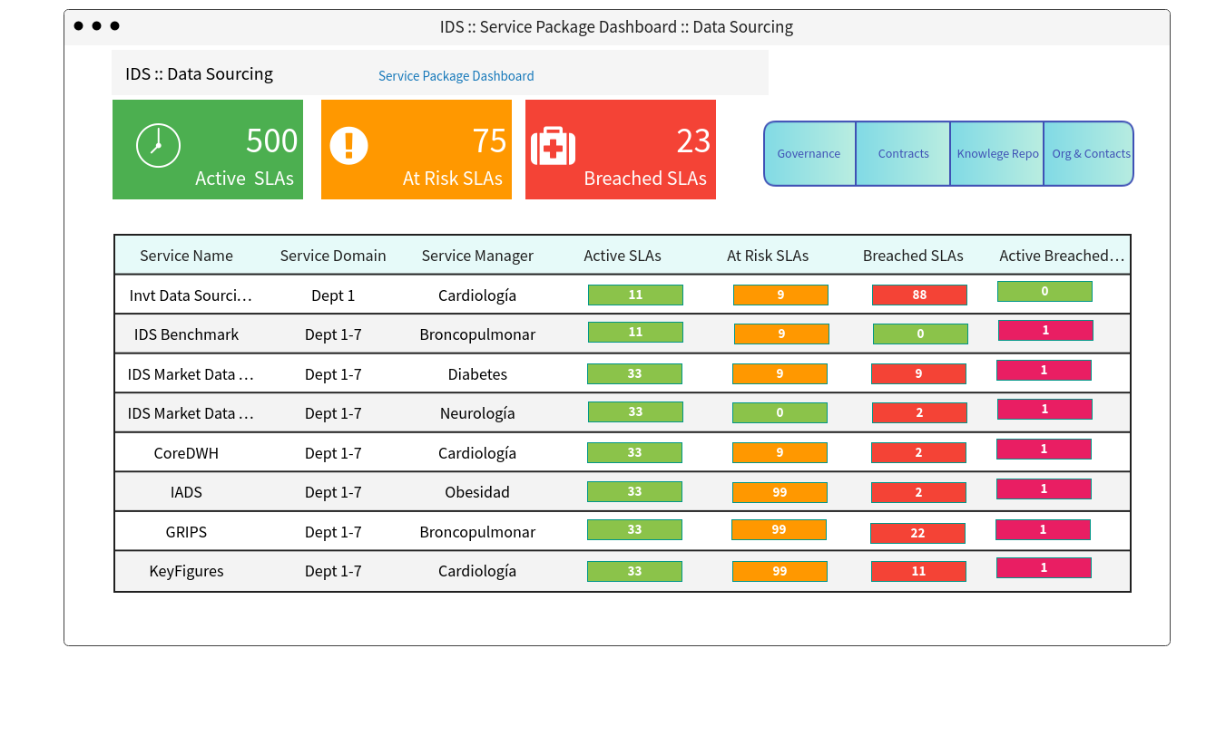
IDS Service package DASHBOARD :: Data sourcing
Service Package level
Service Level Management |Portfolio Overview | DE

Slide 8
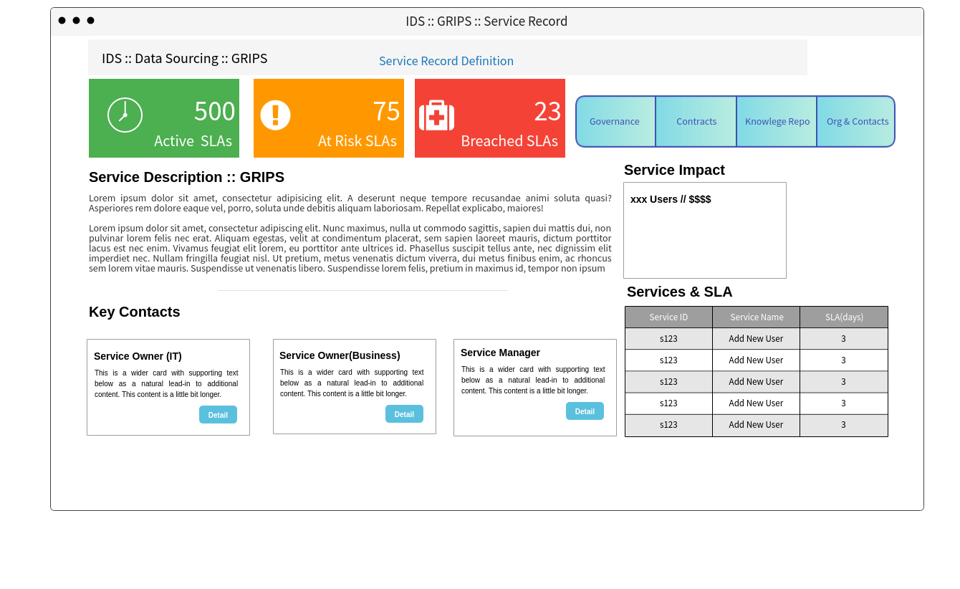
IDS :: Data sourcing :: GRIPS
Service Record level
Service Level Management |Portfolio Overview | DE
Service Record1 | Owner(IT) | Owner(Business) | Service Owner | Documents

Slide 9
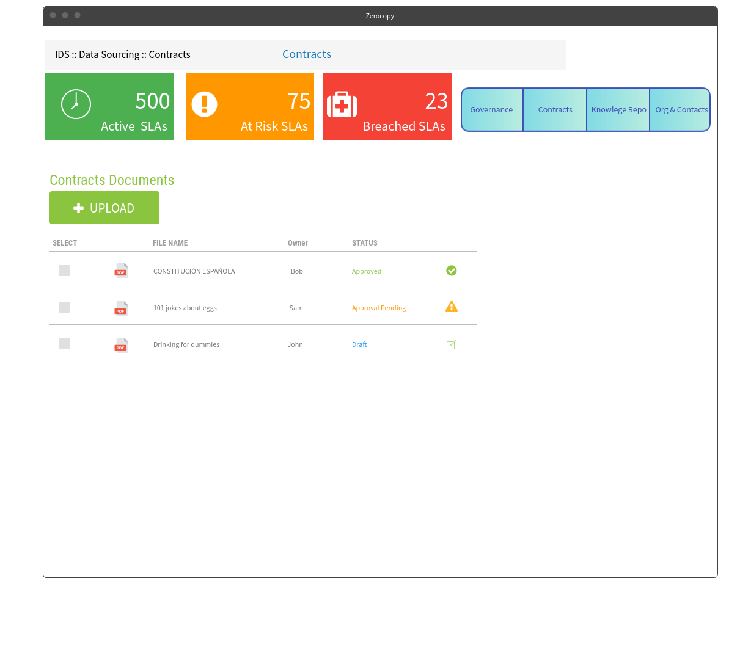
IDS :: Data sourcing :: GRIPS :: Contracts & Documents
Service Record level
Service Level Management |Portfolio Overview | DE

Slide 10
Thank you

